Slide 1
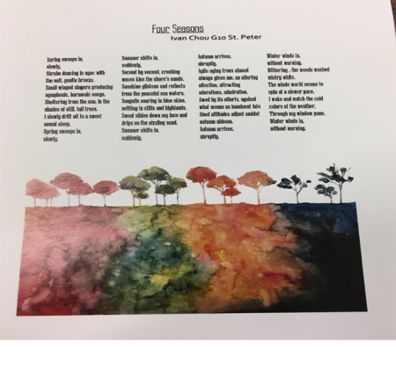
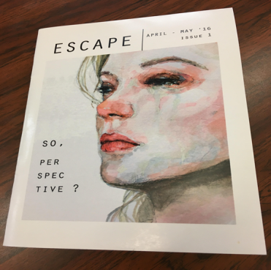
LITERARY ESCAPE
MULTIMEDIA DESIGN

Slide 2
ATHLETICS CLUB
LEARNER’s CLUB

Slide 3
SHOEBOX DELIVERY CLUB
SOCIAL DANCE CLUB

Slide 4
MS & HS GIN
MS & HS MUN

Slide 5
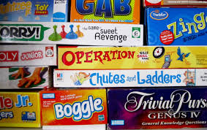
WESTERN CHESS
BOARD GAMES
Ensemble CLUB

Slide 6
DEBATE CLUB
TEDxDominicanIntnl School

