Slide 1
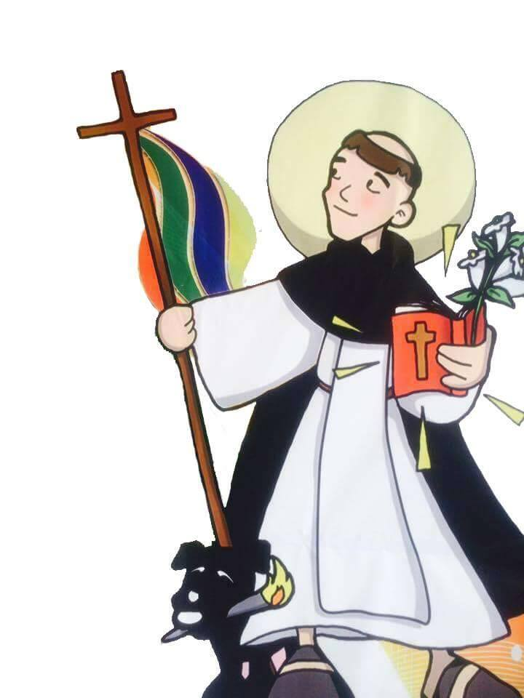
Campus Ministry and Religious Studies

Slide 2
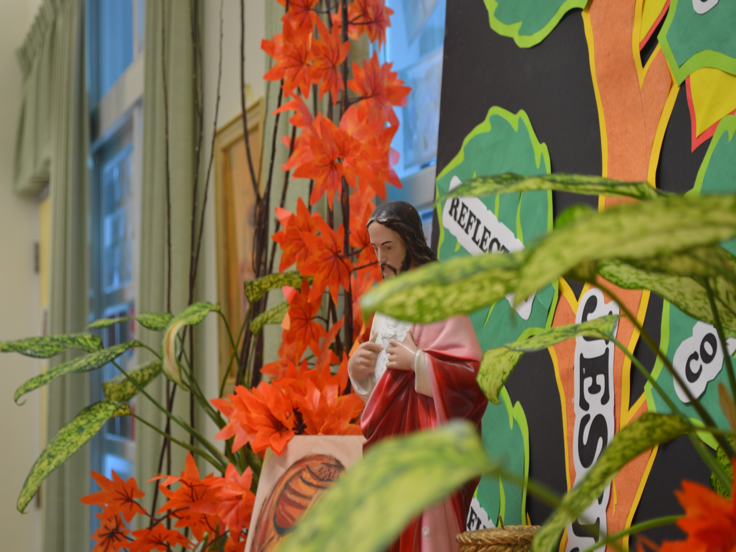
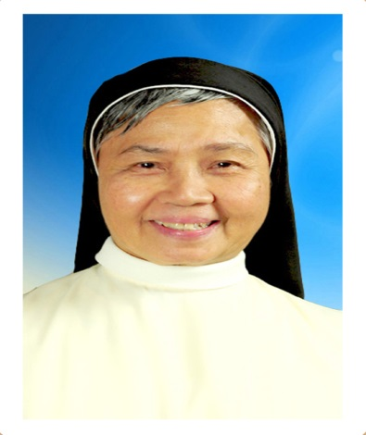
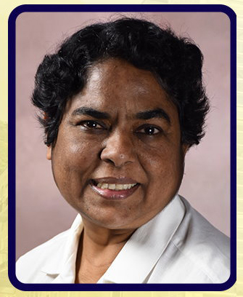
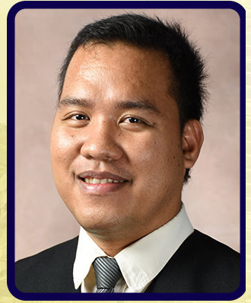
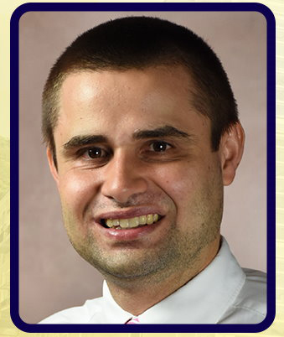
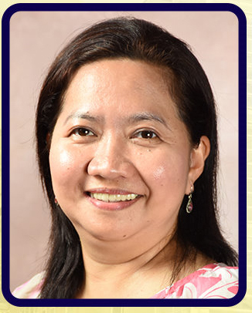
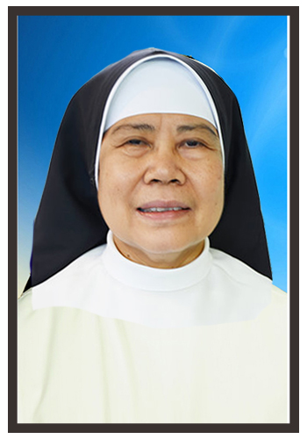
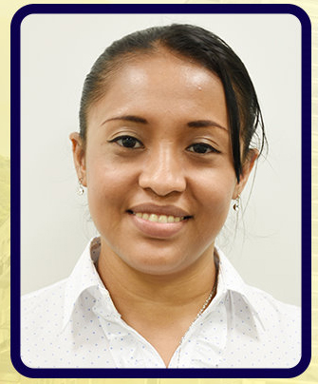
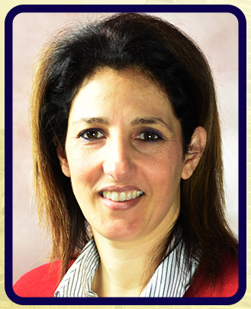
Campus Ministry Team
Sr. Socorro Teofilo, O.P.
Campus Ministry Head
Vice-Principal
Sr. Rosa Dabhi, CCV
CMSL Adviser, Catechist, RS 7,10, and 11
John Erick S. Moje
Religious Studies/CSP Coordinator
RS 6, 8, 9, and 12
Philipp Beck
RS 1,2,3,and 4
SR. AGOSH LIBREA
CSP 12
Sr, Leticia Delfin, O.P
RS 4 and 5
Scarleth Xochilt Artola Cerna RS 2
Mafalda Wu
RS K1

Slide 3
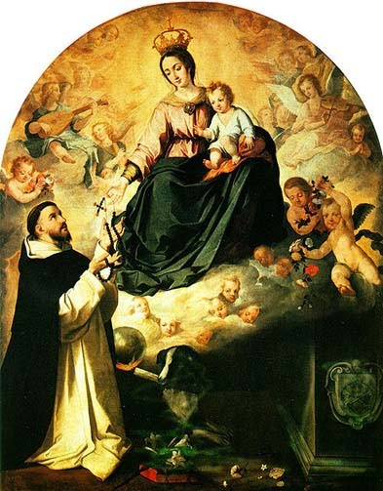
THE DOMINICAN BLESSING
May God the Father bless us,
May God the Son heal us,
May God the Holy Spirit enlighten us,
Give us eyes to see with,
Ears to hear with,
Hands to do the work of God with,
Feet to walk with,
And mouth to preach
The Word of salvation with,
May the Angel of Peace to watch over us
and may he lead us at last
by the Lord’s gift to the kingdom. Amen

Slide 4
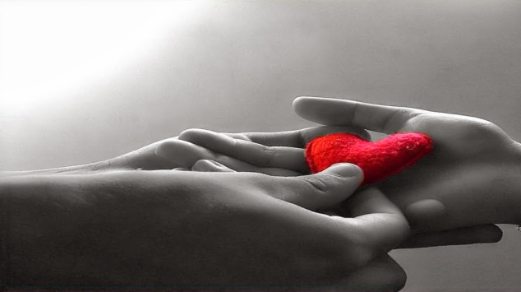
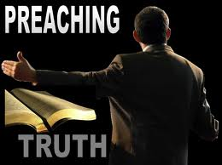
Laudare
“to praise”
Benedicere
“to bless”
Praedicare
“to preach”

Slide 5
Vision-Mission of DIS DIS is an internationally competitive school that offers a holistic learning environment for multi-lingual/cultural learners. KEY POINTS: 1. Internationally competitive school; 2. Holistic learning environment; 3. Multi-lingual/cultural learners;

Slide 6
Mission:
DIS, a Catholic International school, exists to provide a God-centered education committed to create critical thinkers who will be valuable and constructive members of a pluralistic society; We promote and support parents’ role as the first teachers, and work collaboratively with them to realize our goals.
KEY POINTS:
1. Catholic International school/God-centered education;
2. Create critical thinkers students;
3. Constructive members of a pluralistic society;

Slide 7
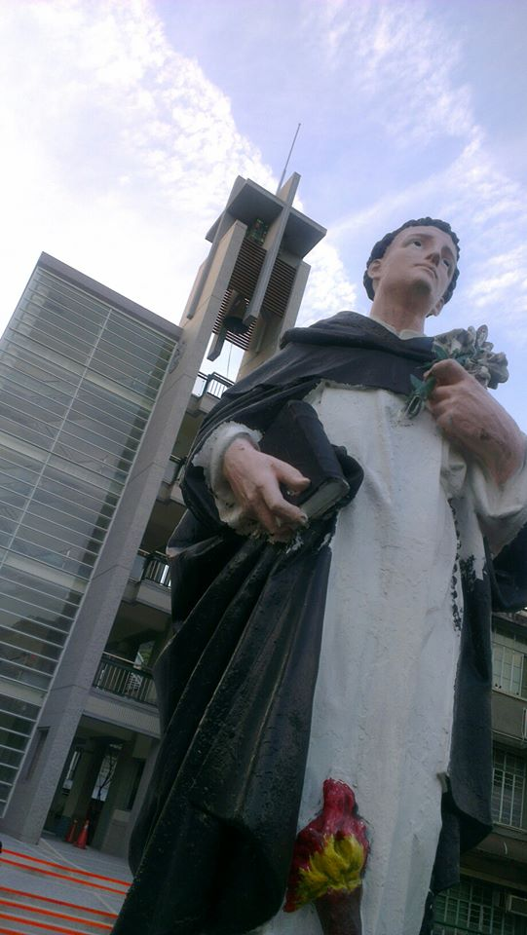
4 Pillars and Dominican CORE VALUES
Study- TRUTH
Prayer-JOY
Community-JUSTICE
Service-COMPASSION
Pray and work
(Ora et Labora)
Pray and Study
(Dominican)

Slide 8
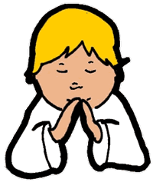
The Four Dominican Pillars
PRAYER
“JOY”
STUDY
“TRUTH”
COMMUNITY
“JUSTICE”
SERVICE
“ COMPASSION”
Praying to God
Love of learning !
Working for a better community
Helping others

Slide 9
WORD
(Instruction/
CL Department)
“In the beginning was the Word, and the Word was with God, and the Word was God. “ John 1:1
Campus Ministry
WITNESS
(Community Outreach Program/
SLP, CMSL)
WORSHIP
( Liturgical Activities: Mass, Retreat, Prayer Service, Leadership Training, Daily Prayer-Angelus)
In the same way, let your light shine before others, so that they may see your good works and give glory to your Father who is in heaven.
Matthew 5:16
Give to the Lord the glory due to His name; worship the Lord in the beauty of holiness or in holy array. Psalm 29:2
CAMPUS MINISTRY FRAMEWORK

Slide 10
WORD: ( DOCTRINAL OR INFORMATIONAL ASPECT) “In the beginning was the Word, and the Word was with God, and the Word was God. “ John 1:1

Slide 18
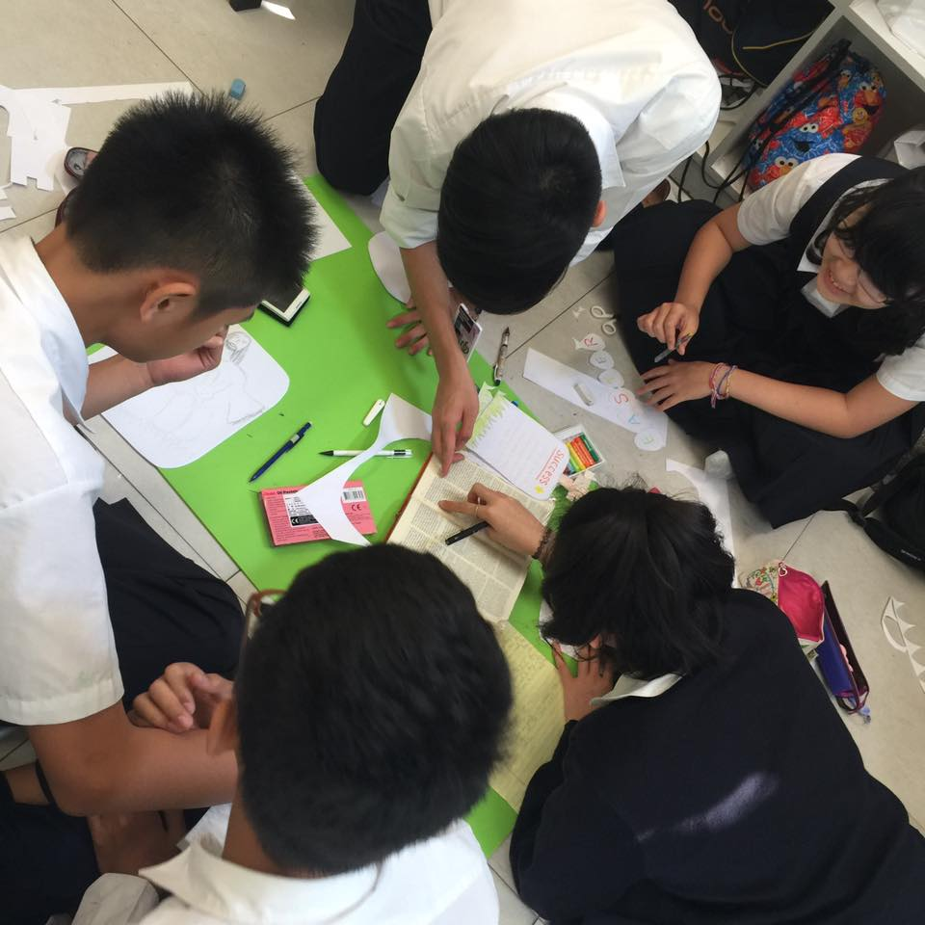
Religious Studies 8 Group Activity for Easter

Slide 19
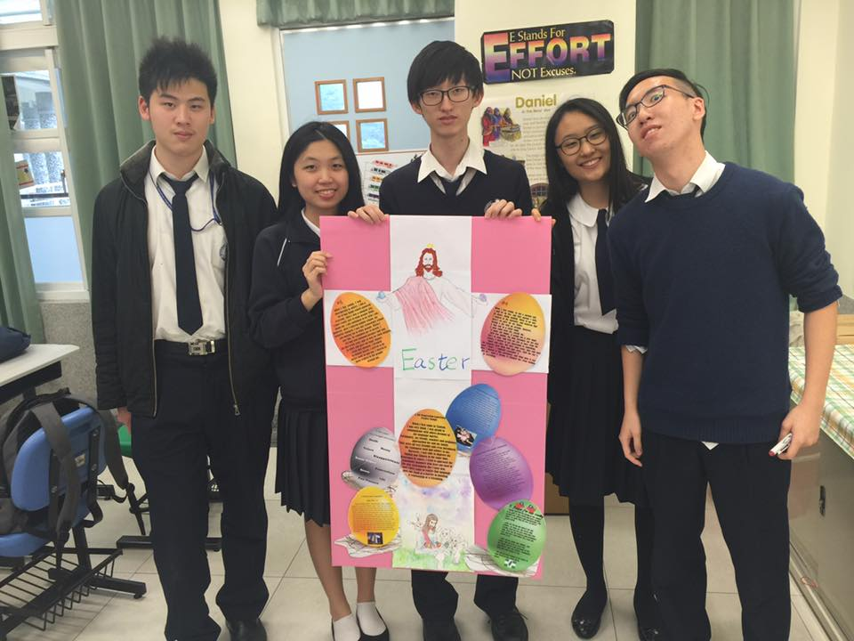
Religious Studies 12 Group Activity for Easter

Slide 20
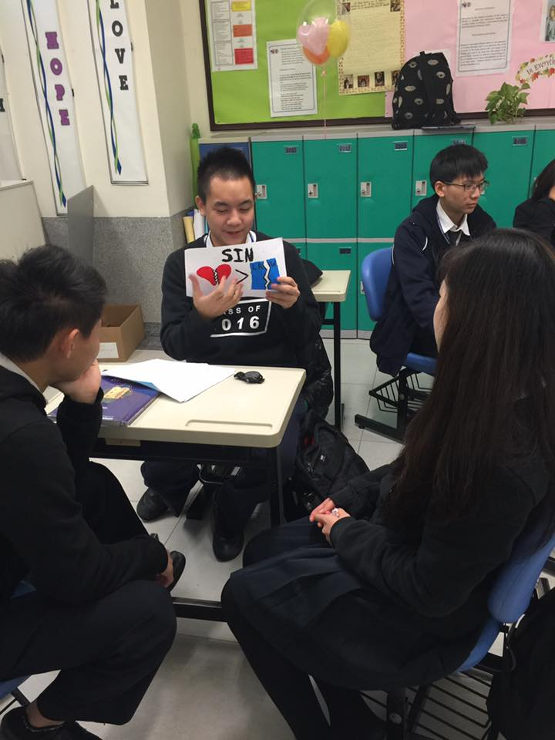
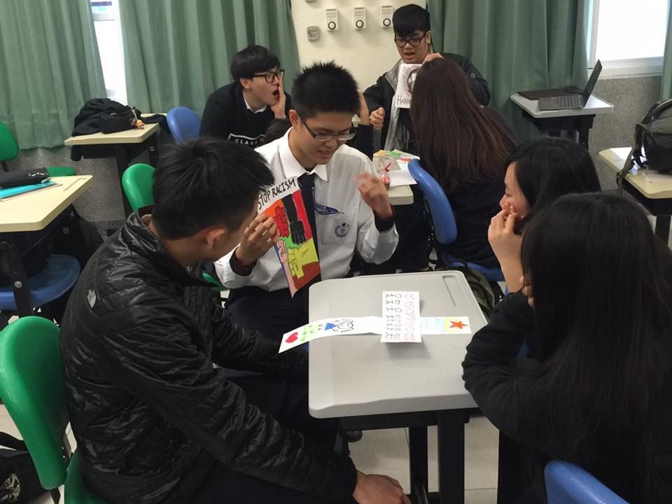
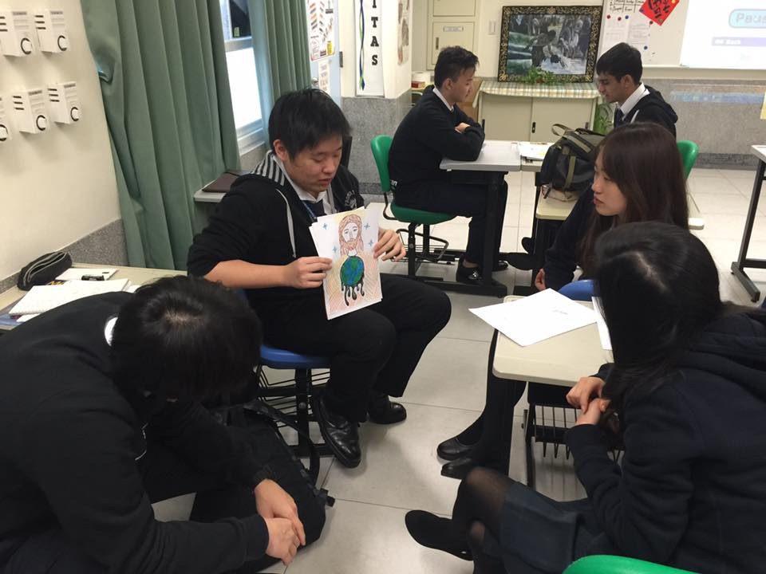
Religious Studies 12 Small Group Reporting about Sin and Forgiveness

Slide 21
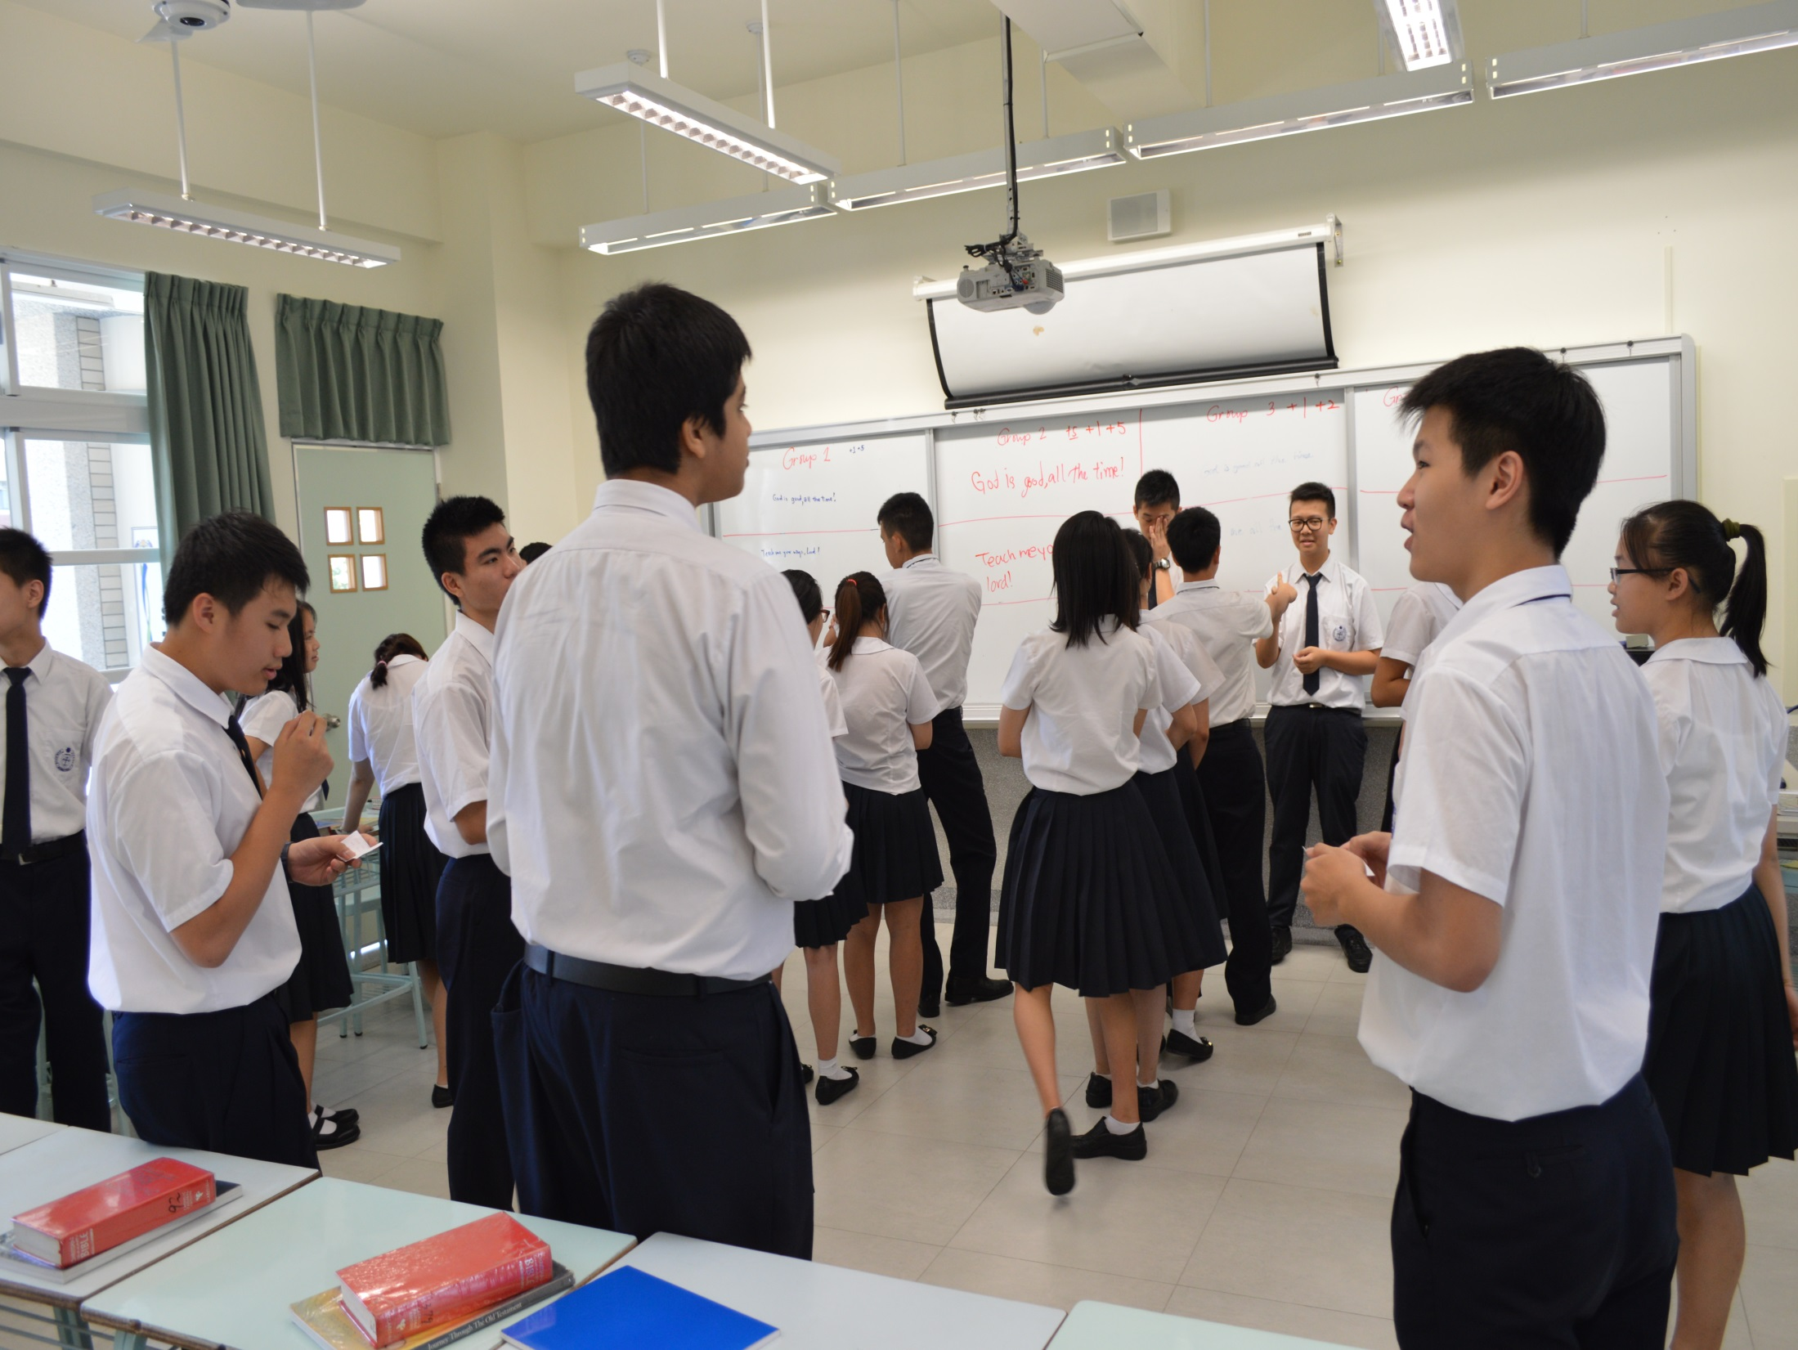

Slide 22
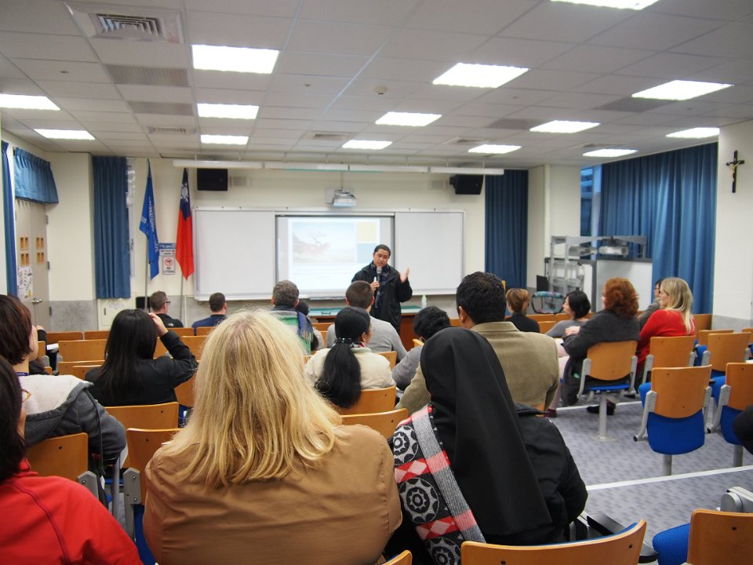

Slide 23
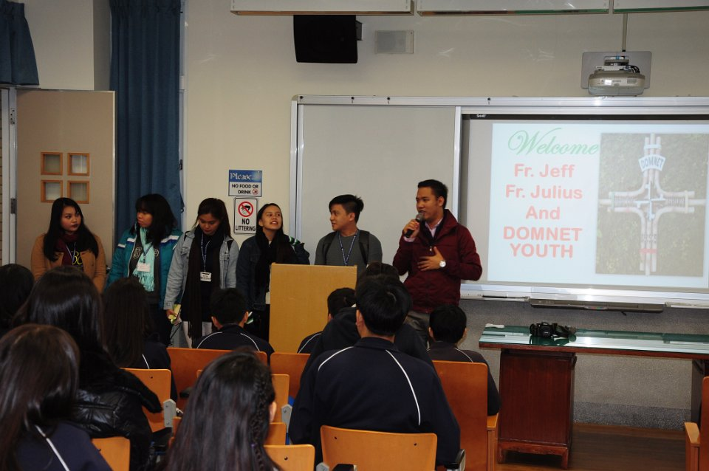

Slide 24
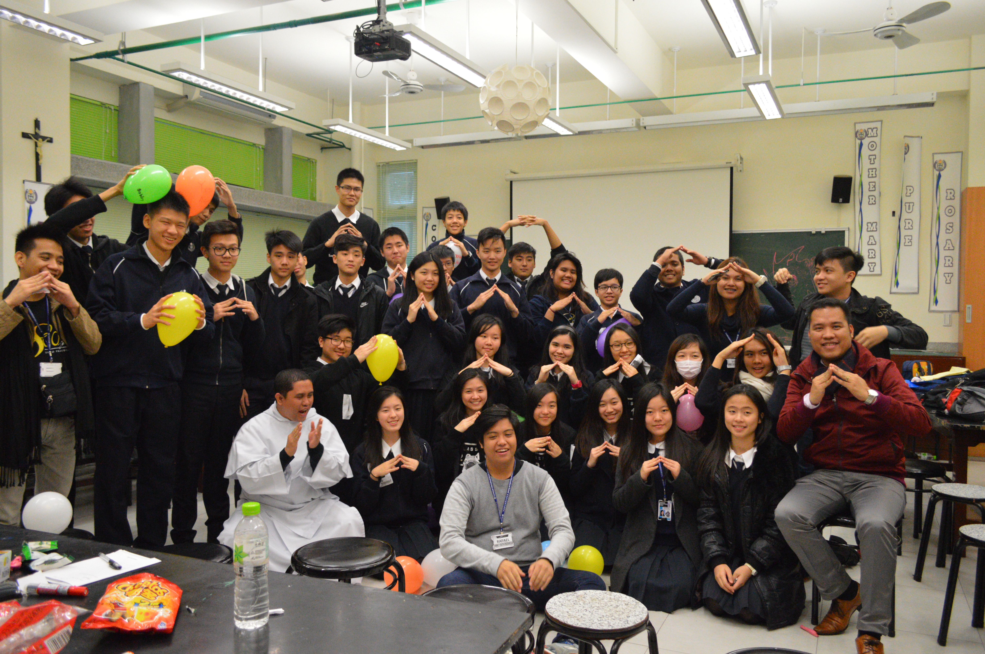

Slide 25
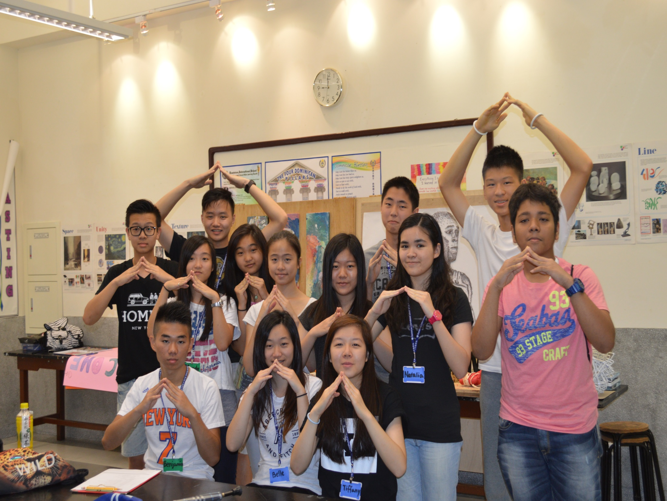

Slide 26
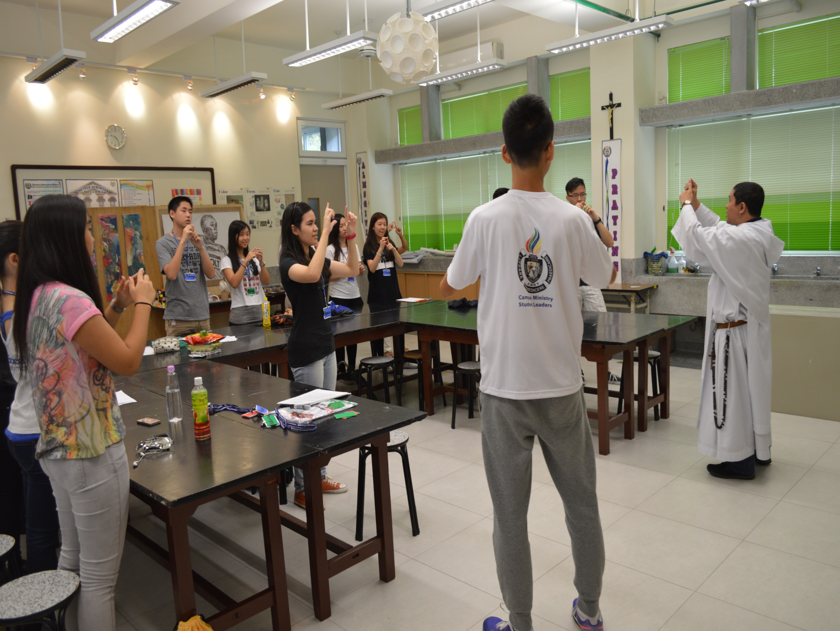

Slide 27
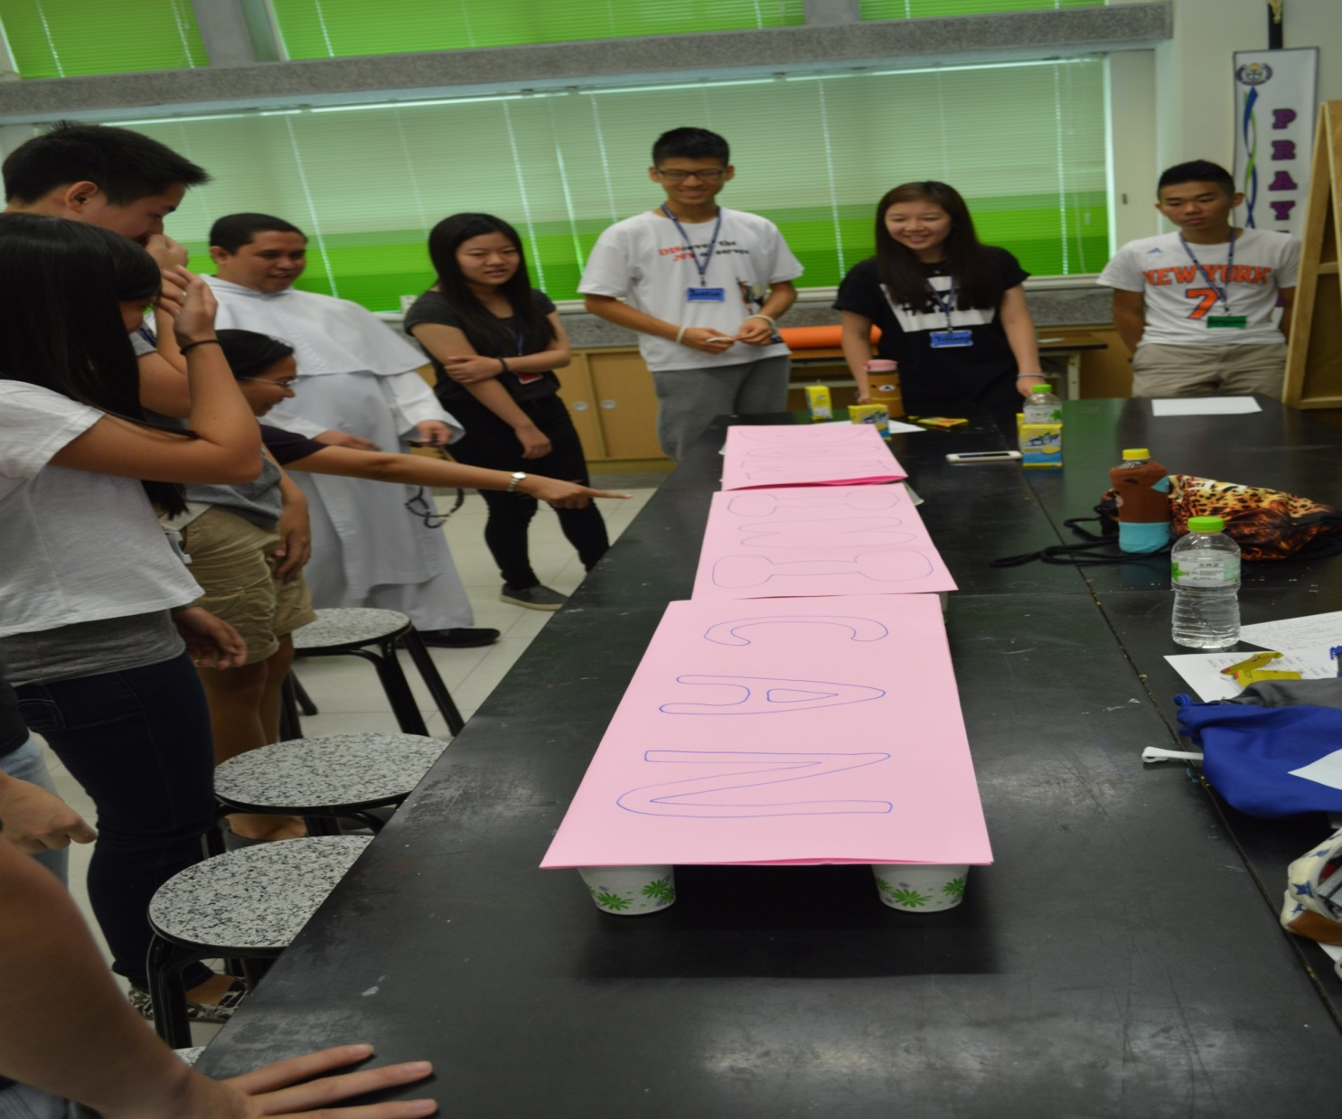

Slide 28
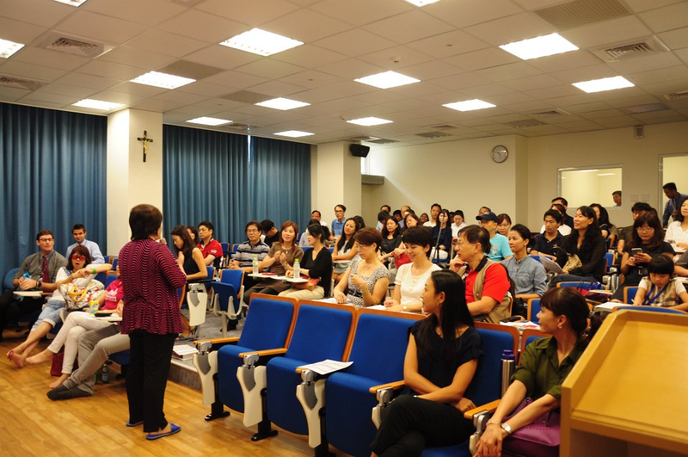

Slide 29
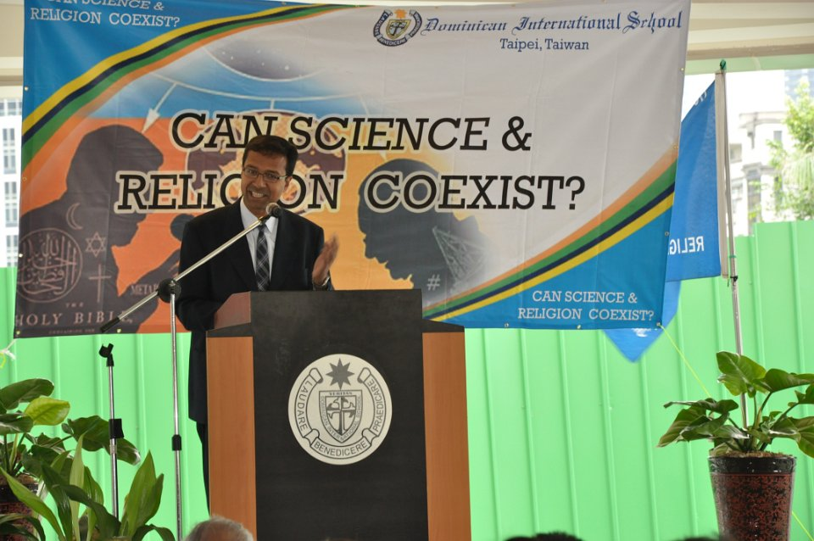

Slide 30
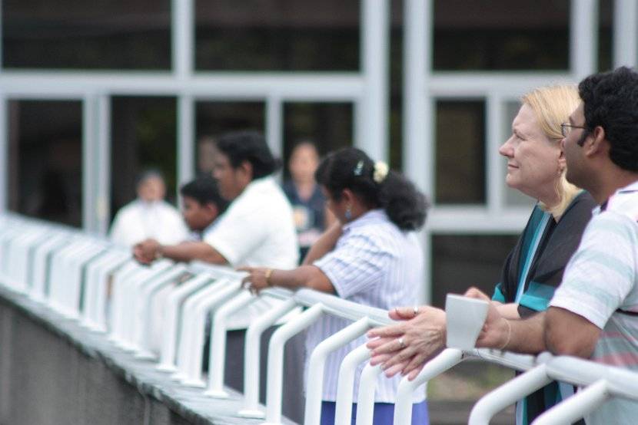

Slide 31
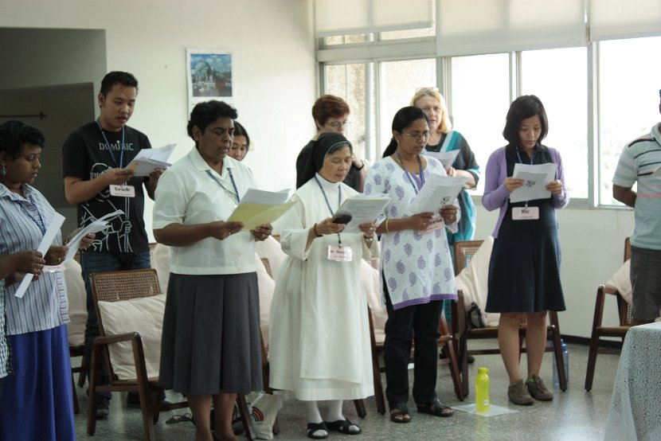

Slide 32
WITNESS: (TRANSFORMATIONAL ASPECT) In the same way, let your light shine before others, so that they may see your good works and give glory to your Father who is in heaven. Matthew 5:16

Slide 33
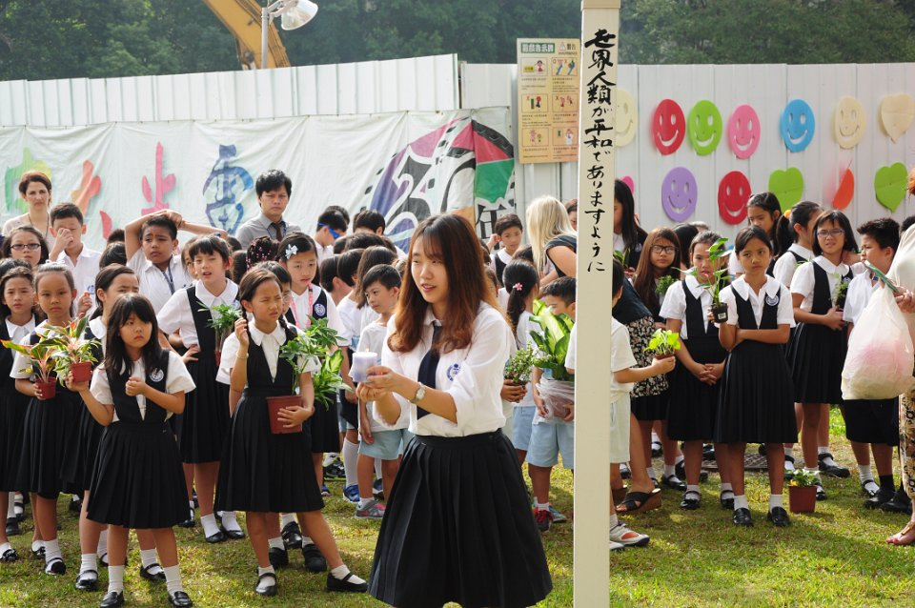

Slide 34
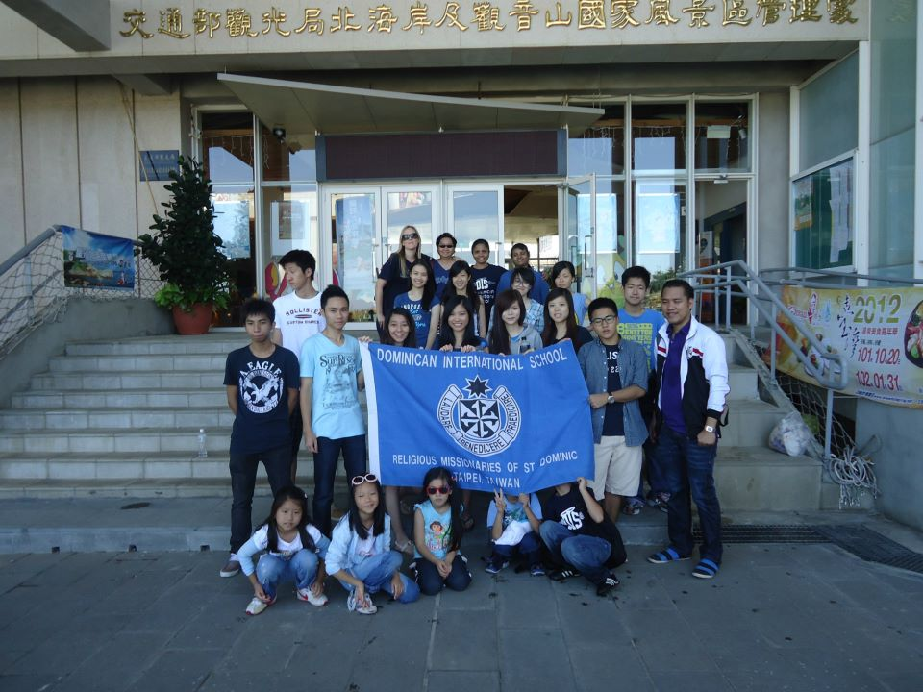

Slide 35
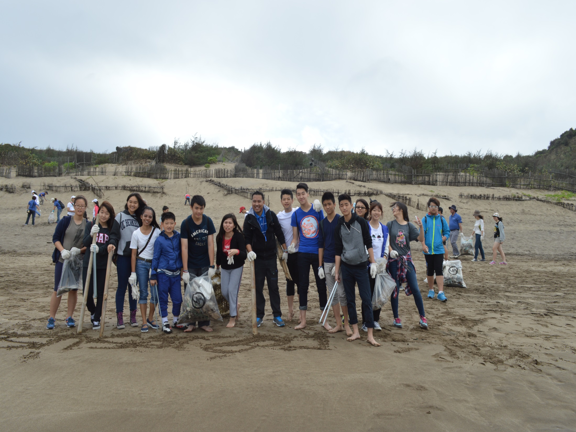

Slide 36
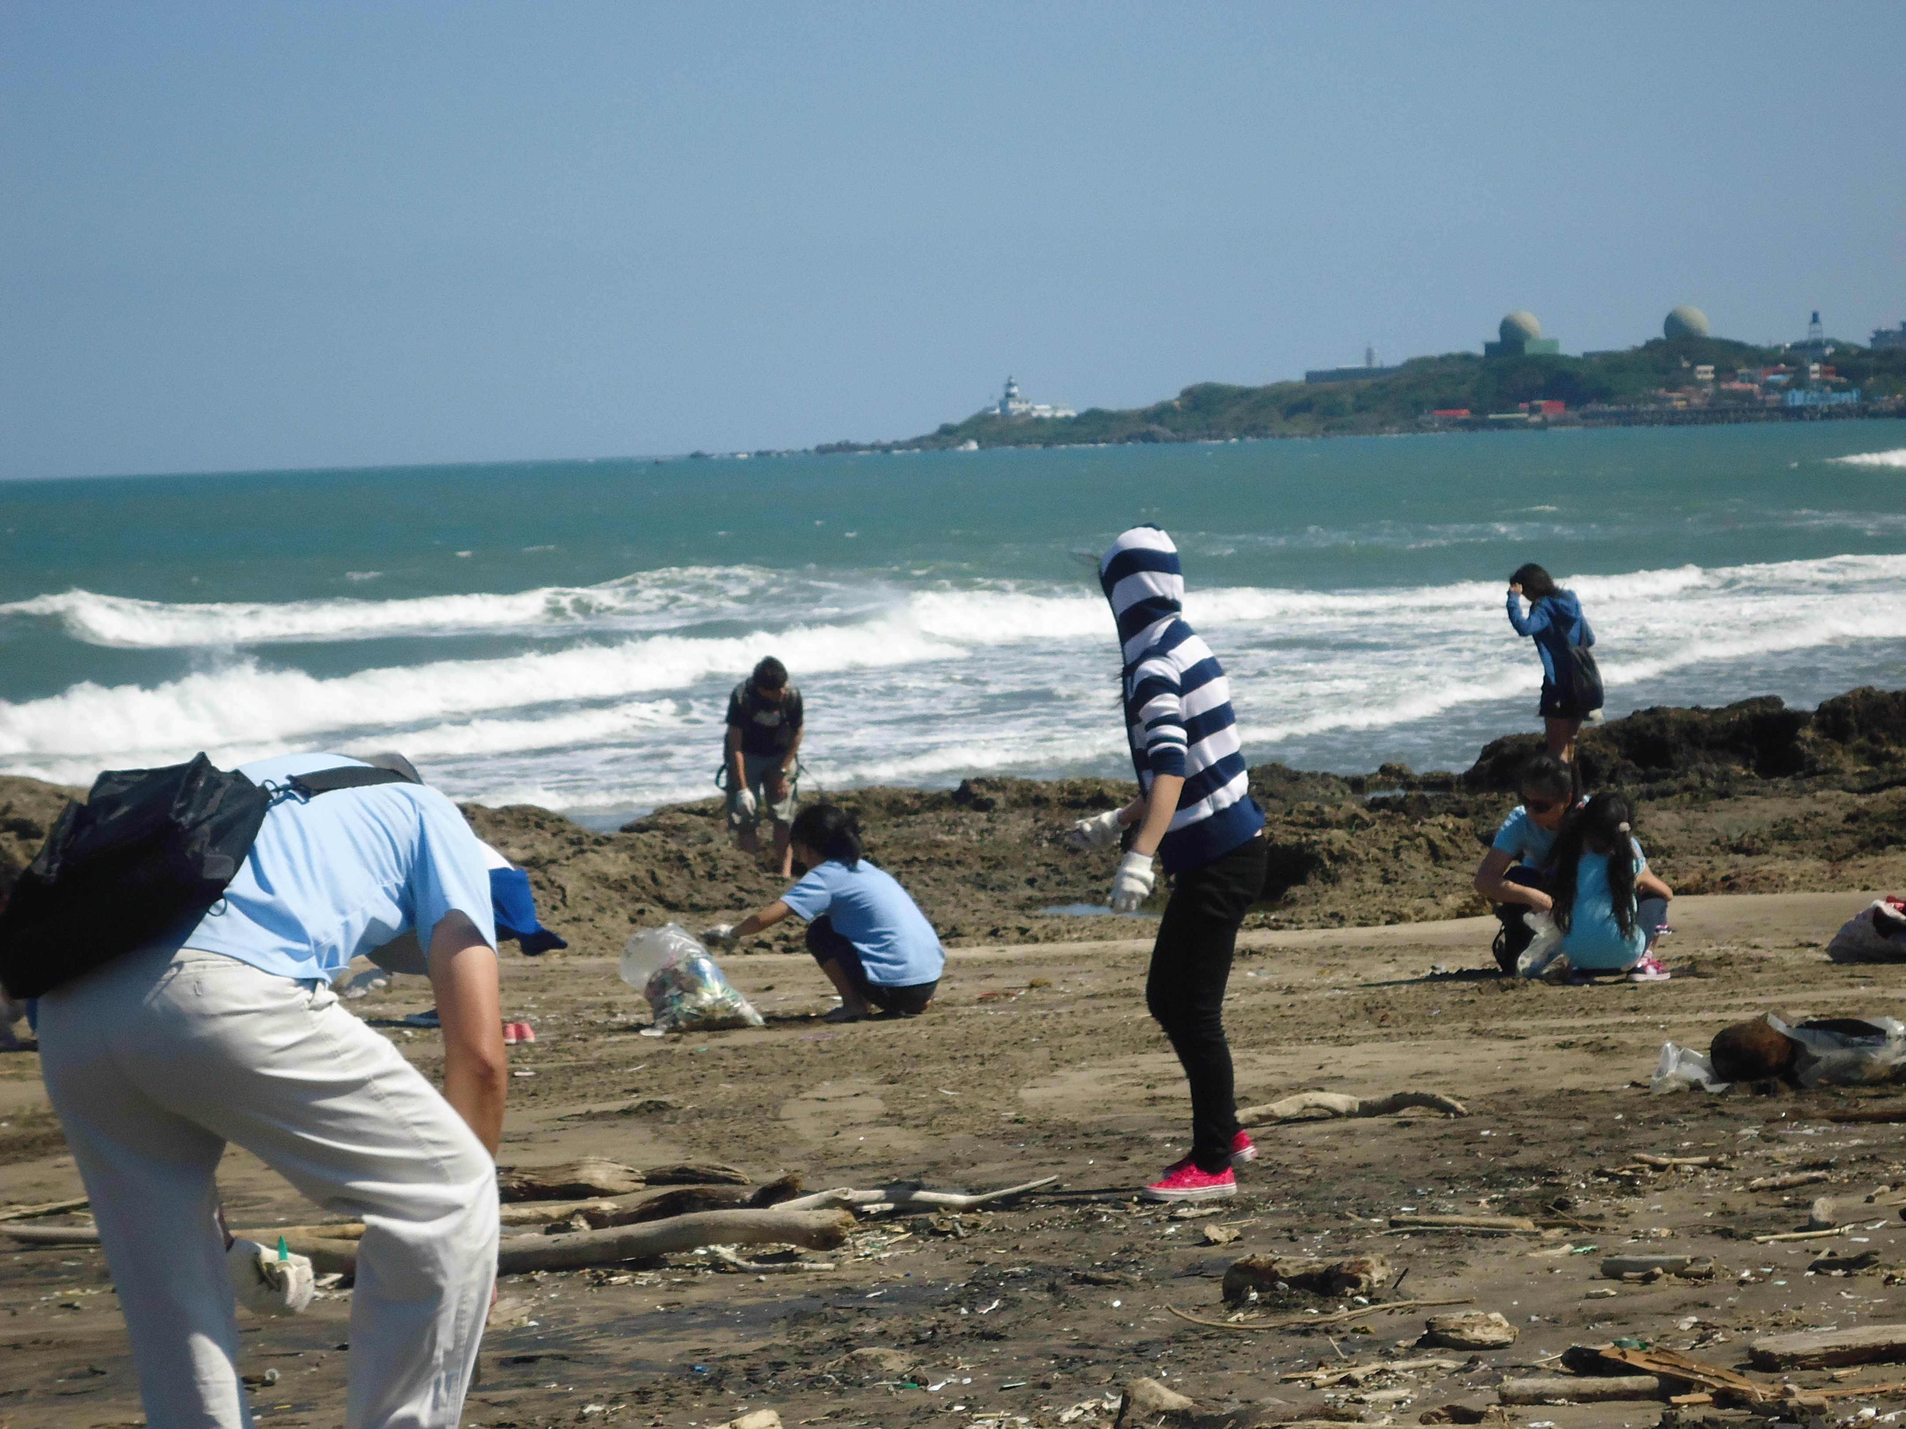

Slide 37
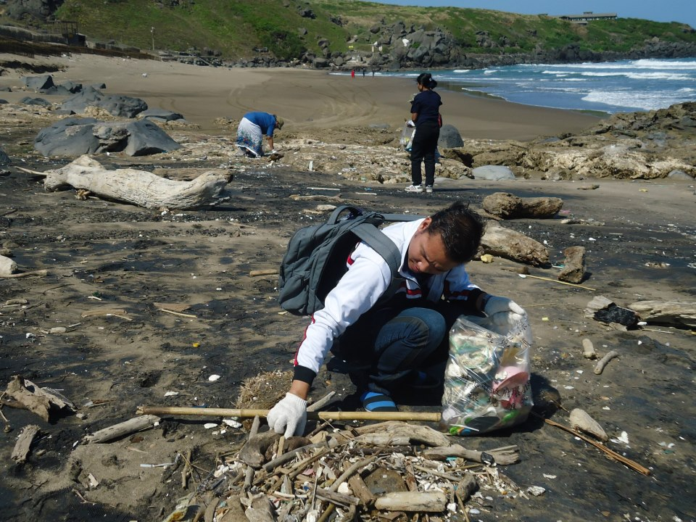

Slide 39
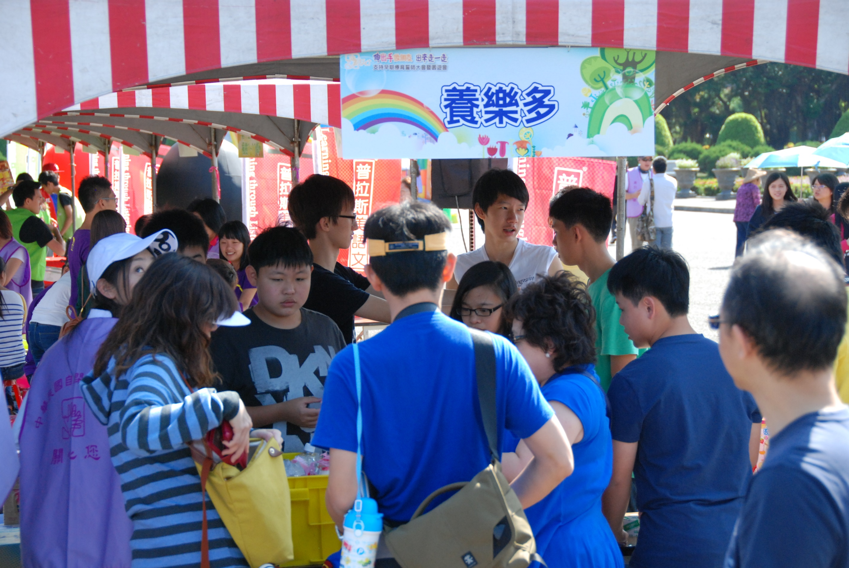

Slide 41
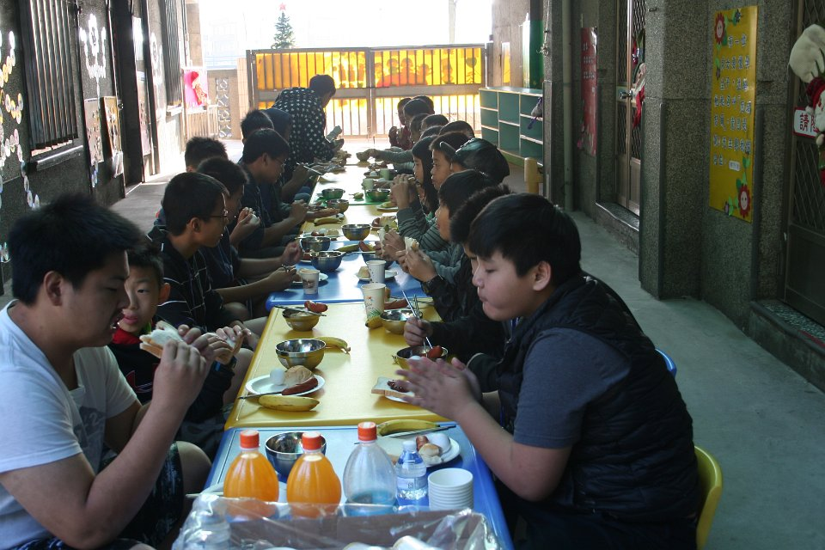

Slide 42
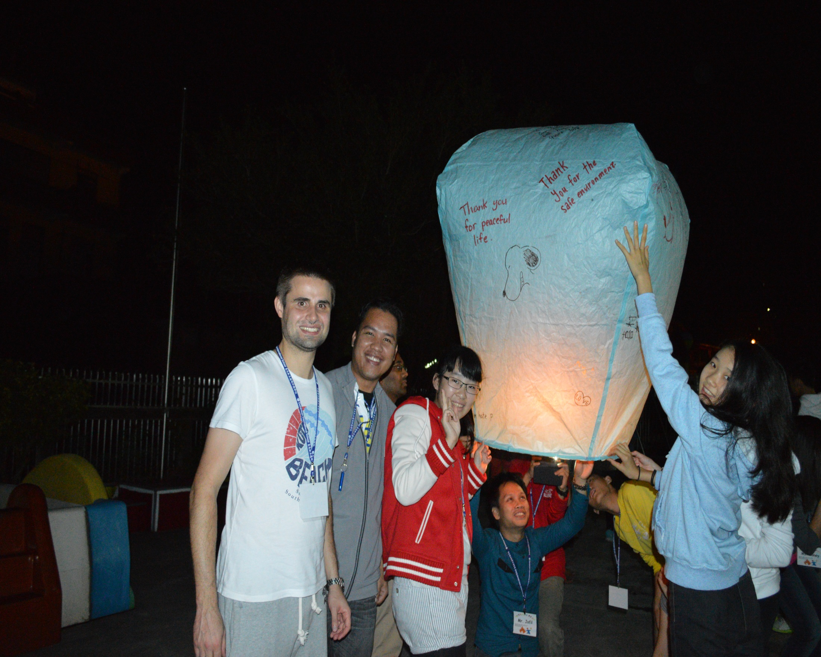

Slide 43
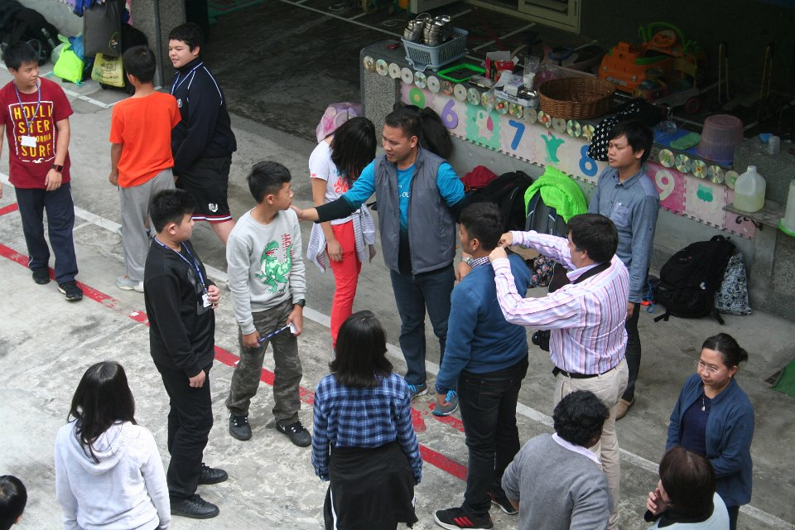

Slide 44
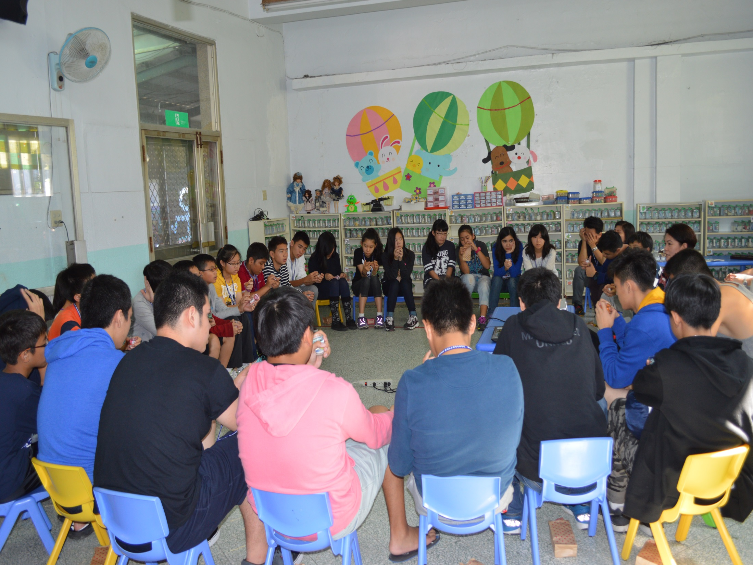

Slide 45
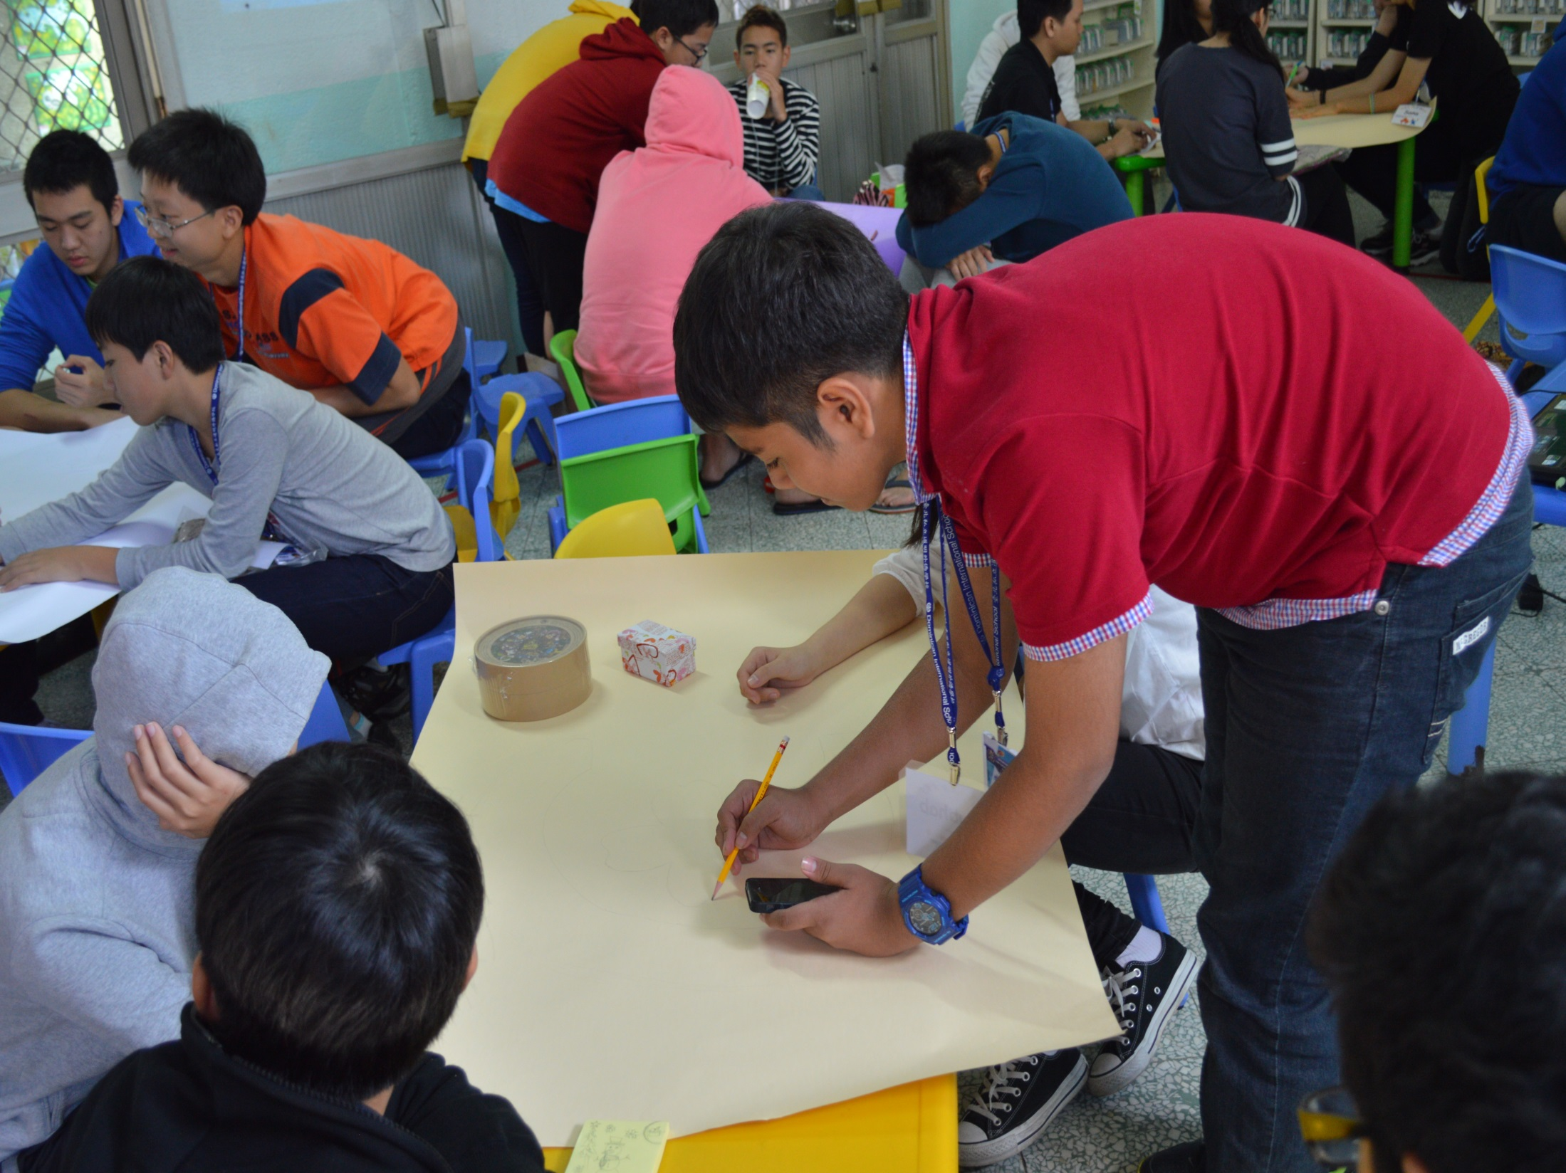

Slide 46
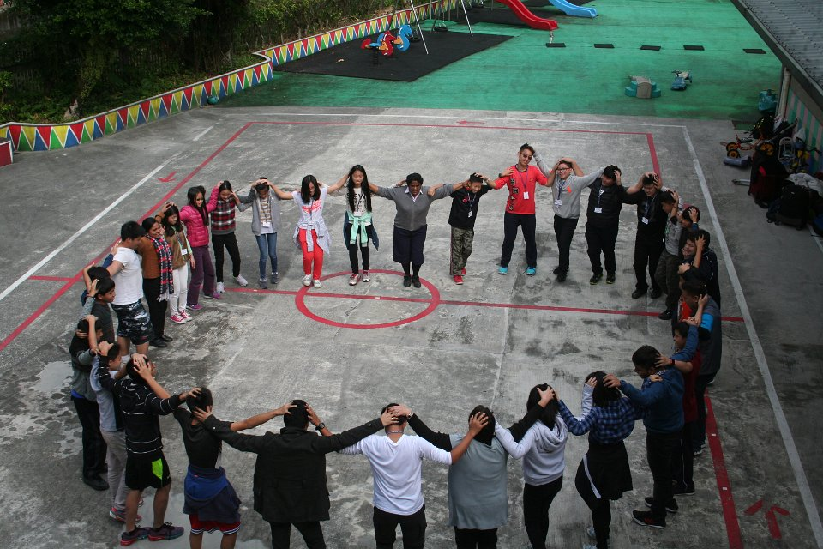

Slide 47
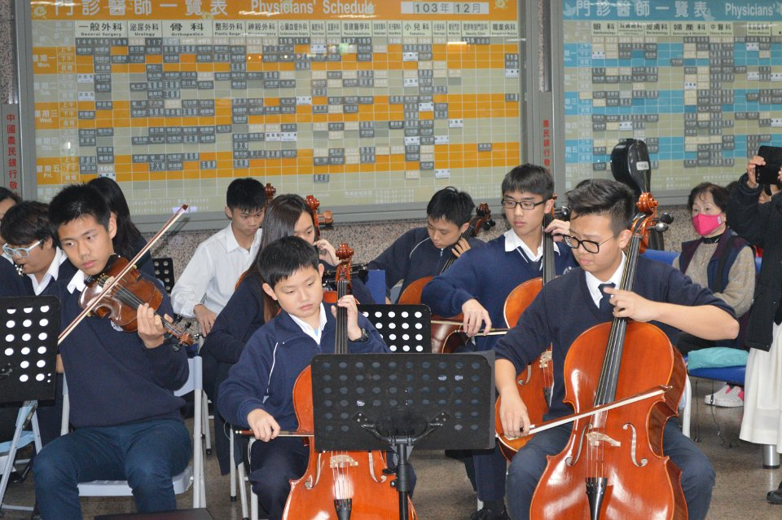

Slide 48
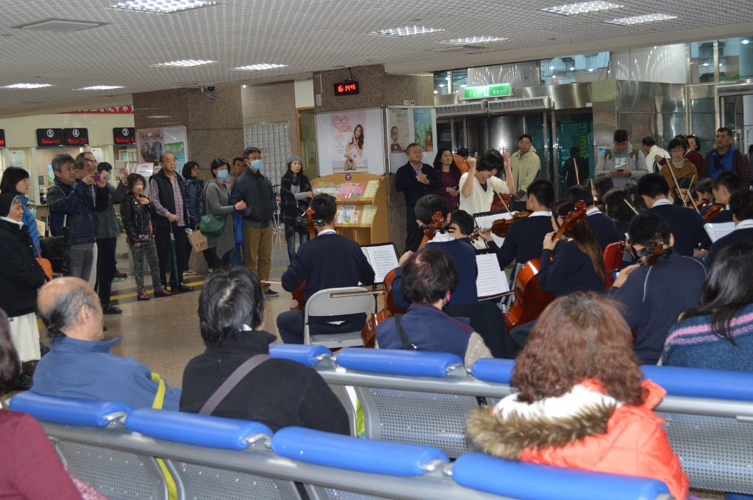

Slide 49
WORSHIP: (DEVOTIONAL ASPECT) Give to the Lord the glory due to His name; worship the Lord in the beauty of holiness or in holy array. Psalm 29:2

Slide 50
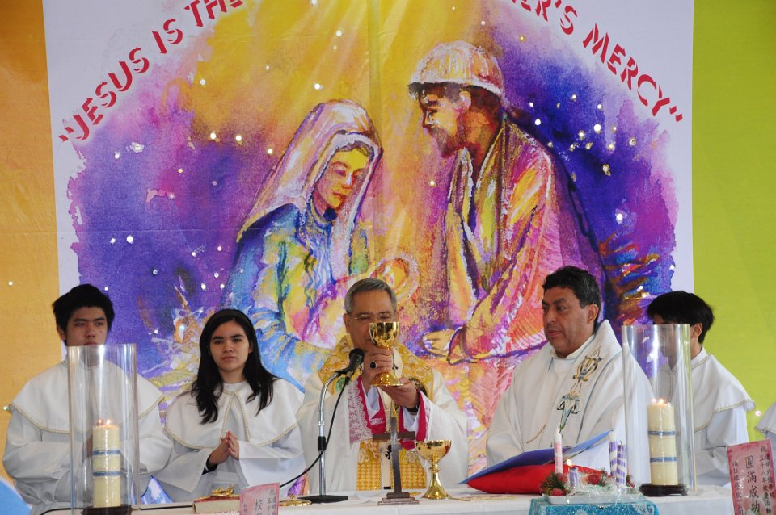

Slide 51
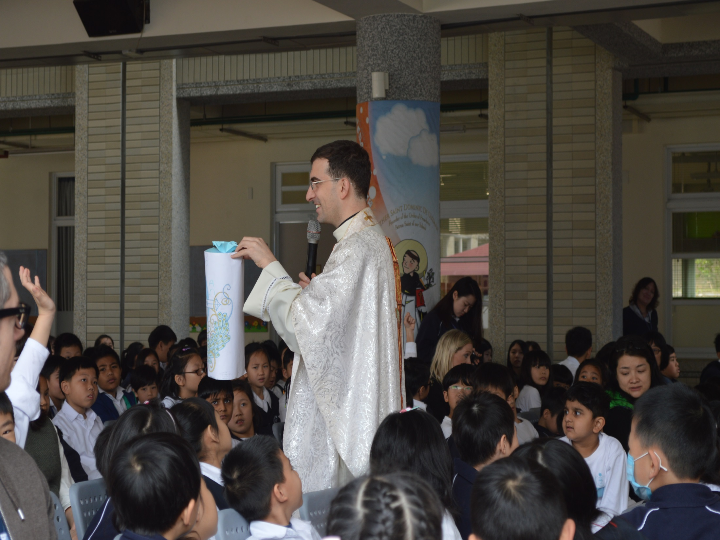

Slide 52
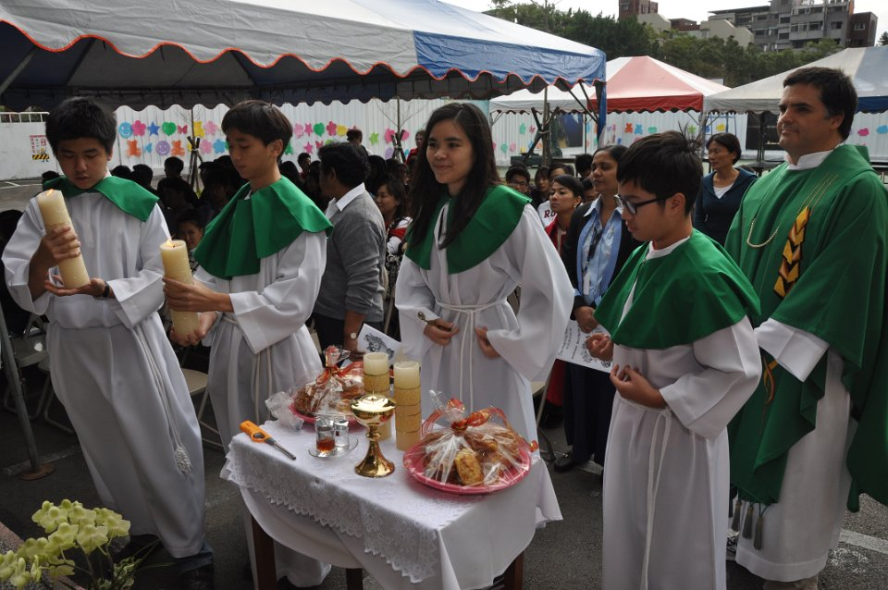

Slide 53
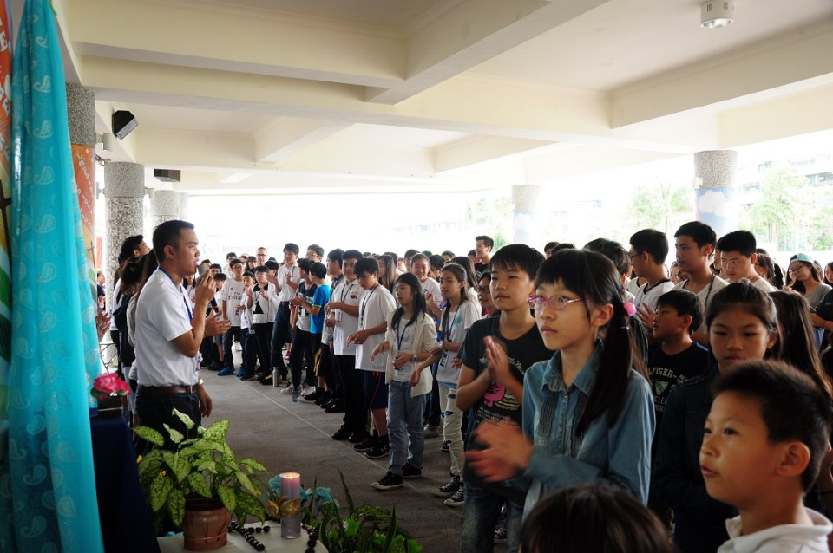

Slide 54
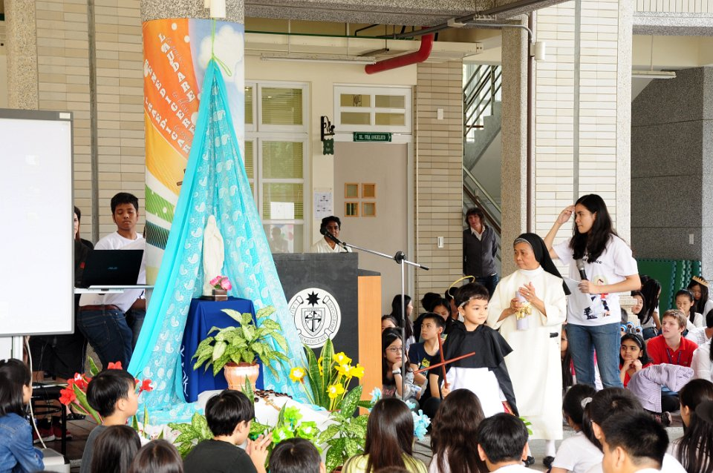

Slide 60
Grading System Academic= 50% + Deportment 50 %
EXPECTED BEHAVIOR FOR D’TORCH
DEPORTMENT GRADING
(50 PERCENT OF STUDENT’S GRADE in Religious Studies)
Prepared by the RELIGIOUS STUDIES DEPARTMENT
T-ruthful…………20 points
O-rganized………20 points
R-eflective………20 points
C-ourageous…..20 points
H-elpful………….20 points
TOTAL……………..100 POINTS

Slide 61
TRUTHFUL……………………..20 POINTS
Shows respect both in words and actions every single person inside and outside the school;
Uplifts ones dignity by honoring others with the same regard as oneself (NO bullying others);
Shows prudence in words and deeds inside and outside the class (No swearing);
Shows HONESTY both in words and deeds;

Slide 62
ORGANIZED………….20 points
Accomplishes the given tasks inside and outside the classroom;
Finishes the given tasks in class;
Brings all the necessary learning materials for class;
Shows punctuality not only in coming to school/class but also in submitting the given subject requirements;

Slide 63
REFLECTIVE…………….20 POINTS
Demonstrates respect for prayer and other Religious activities;
Respects and participates during the celebration of the Mass and other Religious activities;
Shows talent as a gift from God and inspires others to bring out the best in them as well;
Shows reflective and critical mindedness in thinking, speaking, and acting;
Shows discipline and responsibility in using varied types Technology;

Slide 64
COURAGEOUS…20 points
Exerts effort to learn the subject despite difficulty without complain;
Takes risks or challenges and graciously accepts result;
Accepts failure with a positive heart and shows openness to change;
Communicates effectively not only to be understood by to understand others;

Slide 65
HELPFUL…….20 points
Shows initiative to help others inside and outside the classroom;
Shows Compassion and caring inside and outside the classroom;
Contributes for unity and common good;
Respects and cares for the school facilities/ environment;

Slide 66
God bless us all…

